Slide 1
Topic: Right-Angled Triangles
EQ – What are the trigonometry ratios of a right angled triangle?

Slide 2
24
7
30
Date:
Right-Angled Triangles
EQ – What are the trigonometry ratios of a right angled triangle?
Trigonometry is all about comparing the lengths of two sides of a triangle.
When you compare two numbers, that is a ratio.
25

Slide 3
Trig Ratios
Given this triangle, you can make a ratio of the opposite side and the hypotenuse. (Angle x is the reference angle.)
10cm
6cm
x
8cm

Slide 4
Trig Ratios
The ratio of opposite side to hypotenuse is: 6/10 or 0.6.
Knowing the ratio of two specific sides can tell you how big angle x is...
10cm
6cm
x
8cm

Slide 5
Trig Ratios
In this case, an opposite/hypotenuse ratio of 0.6 means that the ref. angle is 36.9 degrees.
Don’t worry how you get that answer yet!
10”
6”
x
8”
i.e. You would not have that ratio if the angle was different

Slide 6
Student Activity
In order to participate with the activities discussed in the next several slides you will need a protractor and a ruler with a metric scale (millimeters).

Slide 7
Trig Ratios
To practice writing trig ratios, make a small table like this:

Slide 8
Trig Ratios
On a blank piece of paper, make a 15cm long line. At the left end of this line, draw a 35 degree angle. Be as precise as possible!
35°

Slide 9
Trig Ratios
Now measure across 30 mm from the vertex, then draw a line straight up. This will form a right triangle.
35°
30 mm

Slide 10
Trig Ratios
Now measure the vertical line and the hypotenuse in millimeters.
…and the hypotenuse
Measure this length...
35°
30 mm

Slide 11
Trig Ratios
With these measurements, fill in the column under the heading: 1st Triangle.
Click to see how this is done…

Slide 12
Trig Ratios
The first box has been filled-in and computed for you. Finish the two below it...

Slide 13
Trig Ratios
Hopefully your answers are similar to these:

Slide 14
Trig Ratios
Now measure 50 mm from the vertex, and make a vertical line. As before, measure the vertical line and hypotenuse.
? mm
? mm
35°
50 mm

Slide 15
Trig Ratios
Then fill-in the column headed 2nd Triangle.

Slide 16
Trig Ratios
Your answers should be close to these:

Slide 17
Trig Ratios
Lastly, measure any distance from the vertex. Create a right triangle, and measure the vertical line and the hypotenuse.
35°

Slide 18
Trig Ratios
Fill-in the column 3rd Triangle with your data:

Slide 19
Trig Ratios
Now compare your data.
Due to measurement error, there might be a few discrepancies when comparing one column to the next, but not much.
Your ratios going across a given row should end up being about the same.

Slide 20
Trig Ratios
Note how all of the opp/hyp ratios are essentially the same.
Note how all of the opp/adj ratios are essentially the same.
Note how all of the adj/hyp ratios are essentially the same.

Slide 21
Similar right-angle triangles have the same shape BUT ARE DIFFERENT SIZE
For similar right angled triangles the 3 ratios are the same
WHY?
These similar triangles are the same shape so they must have the same angles

Slide 22
Trig Ratios
These ratios are unique to a certain angle.
If you had created a 70° angle, and filled-in the three columns as before, your ratios (such as opp/hyp) would all be the same but the value would be different. It would be unique to a 70° degree angle.

Slide 23
Student Activity
Draw a 75° angle.
Create any three right triangles you want from it. (Just like you did with the 35° angle.)
Fill in a chart just like you did for the last problem and compute the ratios.

Slide 24
More on trig ratios
In a perfect world the results for your second table, the 75° angle, should look like this:

Slide 25
Trig Ratios
So what do these results tell you?
First, every angle has a unique result for each of these ratios

Slide 26
Trig Ratios
For example, here are the ratios for a 20° angle:
20°
0.342
0.940
0.364

Slide 27
Trig Ratios
A different angle, say 40°, will have different ratios:
20°
40°
0.342
0.643
Similar Triangles
0.940
0.766
0.364
0.839

Slide 28
Trig Ratios
The other thing to remember is that for a given angle, the size of the triangle you are working with is irrelevant to how the ratios turn out.
Similar Triangles

Slide 29
Trig Ratios
To illustrate this, the angle below (20°) is drawn, then several right triangles are formed. In each triangle the ratio of opp/hyp is the same no matter the size of the triangle.
opp/hyp=
1.82/5.32
= .342
5.32
1.82
20°
Similar Triangles

Slide 30
Trig Ratios
To illustrate this, the angle below (20°) is drawn, then several right triangles are formed. In each triangle the ratio of opp/hyp is the same no matter the size of the triangle.
opp/hyp=
4.37/12.77
= .342
12.77
4.37
20°
Similar Triangles

Slide 31
Trig Ratios
To illustrate this, the angle below (20°) is drawn, then several right triangles are formed. In each triangle the ratio of opp/hyp is the same no matter the size of the triangle.
opp/hyp=
6.55/19.16
= .342
19.16
6.55
20°
Similar Triangles

Slide 32
24
7
30
Date:
Right-Angled Triangles
EQ – What are the trigonometry ratios of a right angled triangle?
How is a right angled triangle labelled for trigonometry ratios?
We are able to find a side length in a right-angled triangle if we are given one other side length and the size of one of the acute angles. T
These sides and angle are related using one of the three trigonometric ratios.
25

Slide 33
24
7
30
Date:
Right-Angled Triangles
EQ – What are the trigonometry ratios of a right angled triangle?
Opp
The three trigonometric ratios are defined as follows:
Sin θ° =
Hyp
Adj
Cos θ °=
Hyp
Opp
Tan θ°=
Adj
S^{O}H
C^{A}H
T^{O}A
25

Slide 34
24
7
30
Date:
Right-Angled Triangles
EQ – What are the trigonometry ratios of a right angled triangle?
How is a right angled triangle labelled for trigonometry ratios?
When solving trigonometry problems, the choice of the ratio depends on the given information.
To choose an appropriate ratio:
consider the sides that are either given or need to be found
select the ratio containing both of these sides.
25

Slide 35

Some
Old
Hippie
Came
A
Hoppin’
Through
Our
Old Hippie
Apartment

Slide 36
24
7
30
Date:
Right-Angled Triangles
EQ – What are the trigonometry ratios of a right angled triangle?
Each of the 3 ratios has a name
The names also refer to an angle
Hypotenuse
Opposite
A
Adjacent
25

Slide 37
24
7
30
Date:
Right-Angled Triangles
EQ – How is a right angled triangle labelled?
B
If the angle changes from A to B
Opposite
The way the ratios are made is the same
A
Adjacent
25

Slide 38
Find the sine, the cosine, and the tangent of angle A.
Give your answer correct to 4 decimal places.
10.8
9
A
6

Slide 39
Find the sine, the cosine, and the tangent of angle A.
Give your answer correct to 4 decimal places.
24.5
8.2
A
23.1
Shrink yourself down and stand where the angle is.
Now, figure out your ratios.

Slide 40
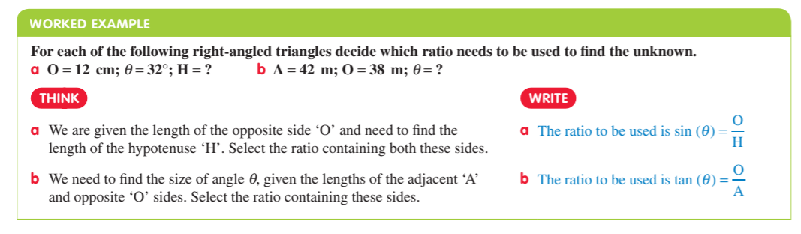

Slide 41
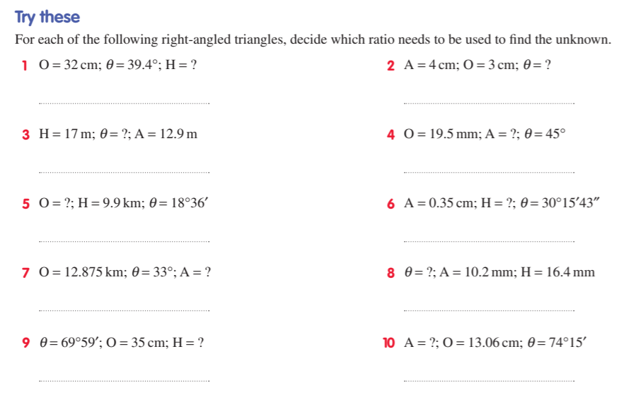

Slide 42
